Slide 1

Anti-Racist Pedagogy Series:
Introduction to Related Theory
July 7, 2020
Faculty Center for Ignatian Pedagogy

Slide 2
Welcome
  Acknowledgements
  The Loyola community occupies the traditional homelands of the people of the Council of Three Fires, the Ojibwe, Potawatomi, and Odawa as well as the Menominee, Miami and Ho-Chunk nations. This was also a site of trade, travel, gathering and healing for more than a dozen other Native tribes and is still home to over 100,000 tribal members in the state of Illinois.
  Thank you to our teachers and mentors, in and outside academia, whose guidance and support allow us to be and do who and what we share with you today.
  Thank you to our contributors: Hector Garcia Chavez,
  Betsy Hemenway, Cristina Lombardi, Cristian Paredes, Ben Penglase, LaShaunda Reese, Shweta Singh, Frederick Staidum Jr., Loretta Stalans, and Elizabeth (Liz) Webster
  Welcome, Loyola colleagues. Thank you for joining us.

Slide 3
Today's agenda
  Welcome
  Intent of session
  Introduction to theories related to anti-racist pedagogy
  Q&A
  Closing

Slide 4
Intent of session
Introduction to theories relevant to anti-racist pedagogy
Discussion of how presented theories can inform anti-racist pedagogy within your discipline
Notes:
Note about the series:
Start with ourselves and our experience
Ready ourselves to learn something new
No quick fix to racism! Cultivating the practice of reflection and action to create a more anti-racism classroom
This will be imperfect, this is not an answer to all of your questions
This is a start to the work we all need to do personally and in our teaching ans scholarship

Slide 5
Shared assumptions
We endeavor to move toward anti-racism in the classroom and as an institution.
We must listen to the experiences of others.
This session will NOT share specific skills, strategies or tools for application of anti-racist pedagogy (*see next sessions)
This session's content is applicable to any instructor, regardless of content you teach
This is the beginning. This is not a certification; we won’t leave as experts. We all have a lot to learn; this session is a piece of the start of the conversation and the work.
Notes:
Note about the series:
Start with ourselves and our experience
Ready ourselves to learn something new
No quick fix to racism! Cultivating the practice of reflection and action to create a more anti-racism classroom
This will be imperfect, this is not an answer to all of your questions
This is a start to the work we all need to do personally and in our teaching ans scholarship

Slide 6
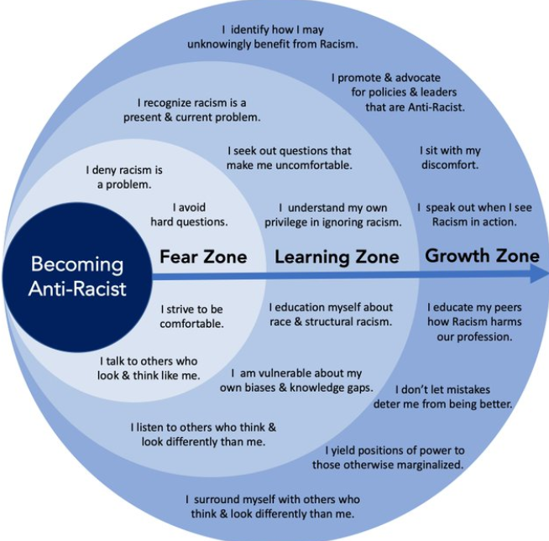
The work of anti-racism

Slide 7
Working Definitions for Anti-Racism Seminar
Loretta J. Stalans
Professor of Criminal Justice and Criminology, Psychology

Slide 8
Power
1. Has three components:
control over allocating resources
to influence or persuade
to control people’s time.
2. Operates at three levels: Systematic/Institutional; Interpersonal; and
Individual. These three levels are intersecting.

Slide 9
Racism
Scholars disagree on the definition of racism.
Imbram X. Kendi, for example, prioritizes systemic bias in policies whereas Robin DiAngelo prioritizes bias in the beliefs and interactions of white persons with people of color (see Kelefah Sanneh, New Yorker, August 19, 2019).
Racism is people of color continuing to receive systemic disadvantages in resources across societal institutions and within interpersonal exchanges due to policies, practices, cultural ideologies, norms, and implicit standards that favor those perceived as White.

Slide 10
White Supremacy
White people mostly control power in the major societal institutions (educational, financial, medical, media, political, artistic, religious, scientific, etc.) and set the “ideal” cultural standards; White people learn to exercise entitlements and race-based assumptions, consciously or unconsciously held, in their informal and formal interactions and decisions, which subordinates and exploits non-whites.
Mills, C. W. (2003). White Supremacy as a Sociopolitical System: A Philosophical Perspective. (pp. 35-48). In Ashley “Woody” Doane and
Eduardo Bonilla-Silva (Eds). White Out: The Continual Significance
of Racism. New York: Routledge.

Slide 11
Racism, White Supremacy, Racial Prejudice
Hide the uniqueness and differences among individuals within racial groups.
Are supported by racial stereotyping and implicit biases that permeate societal culture
Are not limited to individuals involved in hate groups such as Neo-Nazis or KKK
Racial Prejudice is the erroneous feelings, beliefs, and assumptions that result in marginalizing or excluding members of a racial group.

Slide 12
White Privilege
Refers to the many unearned and often unacknowledged benefits of being perceived as White in a racist society. Whites often do not recognize these benefits, which are often reflect the ‘hidden’ societal disadvantages of being non-white.
Peggy McIntosh
Tim Wise

Slide 13
Anti-racism: a starting place
"Anti-racism is the active, on-going process of identifying and eliminating racism by changing
systems,
organizational structures,
policies and practices,
and attitudes and behaviors,
so that power and opportunity are redistributed and shared equitably."
- Adapted from NAC International Perspectives:
Women and Global Solidarity
- Retrieved from Alberta Civil Liberties Research Centre
*italics = my additions

Slide 14
Critical Race Theory and Whiteness Studies for anti-racist pedagogy
Cristina Lombardi-Diop clombardidiop@luc.edu
Loyola University Chicago
Anti-Racist Pedagogy: Theory Session
July 7, 2020

Slide 15
Critical race theory
CRT is a theoretical and interpretative field of inquiry that examines race, racism, and anti-blackness across history, society, and cultural modes of expression.
CTR attempts to understand how victims of systemic racism are affected by cultural perceptions of race and how they are able to present themselves to counter prejudice.
Placing race at the center of analysis, CRT scholars interrogate policies and practices to uncover ways in which racist ideologies, structures, and institutions create and maintain racial inequality.
CRT scholarship traces racism in America through slavery, Reconstruction and Jim Crow, the Civil Rights Movement, and recent events. In doing so, it draws from work by writers like Sojourner Truth, Frederick Douglass, W.E.B. Du Bois, Martin Luther King, Jr., and others studying law, feminism, and post-structuralism.

Slide 16
Critical Race Theory in the classroom
A CRT perspective focuses on knowledge and epistemic processes.
It interrogates and aims to disrupt the ideologies of racism.
It works at the level of the curricular offering, exposing students to culturally and racially relevant texts and practices (the history of the black diaspora, slavery, colonialism, imperialism, racial injustice at present, etc.).
It uses textual close reading and deconstruction as critical practices that reveal ideological biases

Slide 17
Whiteness Studies
Whiteness Studies is a field of inquiry that investigates how dominant economic, political, social, and cultural structures, as well as actions and beliefs, systematize and perpetuate an unequal distribution of privileges, resources, and power between white people and people of color.
WS scholars argue that whiteness is a specific dimension of racism that elevates white people over people of color.
Whiteness is a location of structural advantage of race privilege and a standpoint from which white people look at themselves and others. (Frankenberg, 1993)

Slide 18
Whiteness Studies (cont.)
For scholars of WS, racism is not only about discrete and isolated behavior and instances of racial discrimination, but it is a social process in which we all have a place (Frankenberg, Morrison).
One of the findings of WS is that whiteness presents itself as ‘transparent’ or ‘invisible’ because it is considered universal, it is often unnamed, and unmarked [white people are just people] (Dyer).
Because of their insulated environment of racial privilege, when confronted with dealing with race, white people exhibit defensive reactions in order to protect themselves from race-based stress: anger, fear, guilt, silence, etc. The reaction ultimately contributes to reinstate “white racial equilibrium” (Di Angelo, “White Fragility,” 2011, 54)

Slide 19
Whiteness Studies in the classroom
Anti-racist pedagogy based on WS focuses primarily on white students.
It is based on the premise that white racism is ultimately a white problem and the burden for interrupting it belongs to white people.
It takes as its goal raising awareness among white students of their racial privileges in order to enable them to work for social justice and become anti-racist agents of change.
Experiential/Service-learning assignments provide (white) students with knowledge through observation of the social realities of racial ethnic groups, enabling them to become coalition-builders.
Problems with WS in anti-racist ed: it gauges success by the extent to which white students develop an awareness of racism, but it sidelines students of color (Blackwell, 2010).

Slide 20
CRT + WS in the Classroom: Recommendations
Classroom discussions should focus on color blindness, denial of race, and conflating of race/class/gender discrimination that makes race invisible.
Adoption of a black feminist standpoint: Allow black students (women of color) to learn using their own standpoint experience and practices. Instructor draws on multiple perspectives, building on students’ ideas and languages
Engagement with students of color: Use their stories and experiences as a site of learning for their own aims
Instructors should model how to honor students of color’s experiences and learning trajectory with critical and thoughtful engagement.

Slide 21
CRT and WS: Recommendations
Devise activities that interrogate how racial identities are constructed in social spaces on campus (the classroom, the clubs, the gym, the sports facilities, the academy in general)
Avoid power struggles: Discrimination Olympics; white vs. black
Let go of a desire to know the Other: Comprehension is not always attainable. Recognize the limitation of one’s knowing.
Post-structuralist lesson: social identities in the classroom are not neatly defined and packaged.
Create a classroom space for understanding the meaning of experiences with and for students of color: create a safe space for them.

Slide 22
Anti-racism beyond the classroom
The institution should broaden professional, experiential, and academic opportunities for students of color: internships, study-abroad, job shadowing, fellowships, etc.
Black-only spaces as safe spaces (ethnic-themed housing/residential halls)

Slide 23
References and suggested readings
Critical Race Theory
Bell, Derrick A. “Who’s Afraid of Critical Race Theory?” University of Illinois Law Review 4 (1995): 893-910.
Crenshaw, Kimberlé, Neil Gotanda, Gary Peller, and Kendall Thomas, eds. Critical Race Theory: The Key Writings that Formed the Movement, 1995
Davis, Peggy. “Law as Microaggression.” Yale Law Journal 98 (1989): pp. 1559-1577.
Delgado, Richard and Jean Stefancic. Critical Race Theory: An Introduction, 2001.
Du Bois, W. E. B. The Souls of Black Folk, 1903
Fanon, Franz. Black Skin, White Masks, 1952
Gates, Henry Louis. The Signifying Monkey: A Theory of African American Literary Criticism. New York: Oxford University Press, 1988
hooks, bell. Black Looks: Race and Representation. 1992
Lorde, Audre. Sister Outsider, 1984
Ta-Nehis Coates, Between the World and Me, 2015
Whiteness Studies
Dyer, Richard. White: Essays on Race and Culture, 1997
Frankenburg, Ruth. White Women, Race Matters: The Social Construction of Whiteness, 1993
Morrison, Toni. Playing in the Dark: Whiteness and the Literary Imagination, 1992
Roediger, David R. Working Towards Whiteness, 2005
Rothenberg, Paula. White Privilege: Essential Readings on the Other Side of Privilege, 2002
Anti-racist pedagogy
Blackwell, Deanna. “Sidelines and Separate Spaces: Making Education Anti-Racist for People of Color.” Race, Ethnicity and Education, Vol. 13, n. 4, December 2014, pp. 473-494.
Blakeney, Alda. “Anti-racist Pedagogy: Definition, Theory, Purpose, and Professional development.” Journal of Curriculum and Pedagogy, Vol. 2, Issue 1, 2005, pp. 119-132.
Di Angelo, Robin. “White Fragility.”, vol. 3 (3), 2011, pp. 54-70. International Journal of Critical Pedagogy

Slide 24
Race as a social construction
Elizabeth Webster

Slide 25
What Is Race?
“…a symbolic category, based on phenotype or ancestry and constructed according to specific social and historical contexts, that is misrecognized as a natural category.”
    Matthew Desmond and Mustafa Emirbayer,
“What is Racial Domination?”

Slide 26
Race is a Social Construction
Race
Phenotype
Ethnicity
Ancestry
Nationality

Slide 27
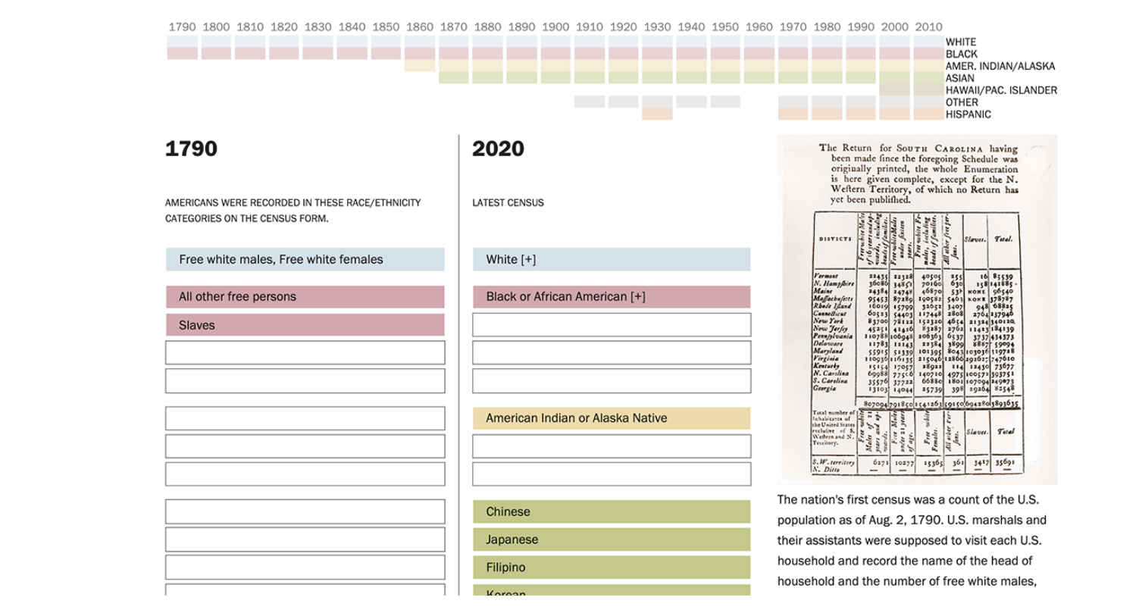

Slide 28
Multiculturalism and Antiracism
Ben Penglase, PhD
Associate Prof of Anthropology
and Latin American and Latinx Studies
bpengla@luc.edu

Slide 29
Some (provisional) definitions
Multiculturalism: the recognition of cultural and ethnic heterogeneity, and a call to recognize, rather than ignore or repress, cultural difference
Antiracism: a stance that seeks to actively challenge and dismantle race, racialization and racial inequality
Multiculturalism as:
  A critical theoretical stance: challenging Eurocentrism
  A political/legal project

Slide 30
Multiculturalism and Antiracism:
Some Differences
Culture vs Race:
  Culture: systems of meanings which guide social action, are shared, and are passed down from one generation to another
  Race: a social and cultural construct that categorizes people into ranked groups based upon perceived physical traits
Blurred boundaries:
  “Race” is also always cultural
  Cultural essentialism as “racism without race”? (Balibar 1991; Stolcke 1995)
The “anti-” in antiracism?

Slide 31
Multiculturalism and Possible Lessons for Antiracist Efforts
Critiques of multiculturalism
  multiculturalism’s conceptualization of “culture”
  multiculturalism’s relatively easy absorption by neoliberal states and institutions
Lessons/warnings for anti-racist efforts?

Slide 32
Feminist theory and anti-racist pedagogy
Betsy Jones Hemenway, Director, WSGS
Shweta Singh, Associate Professor, Social Work; Affiliate faculty, WSGS

Slide 33
What is feminist theory?
Multiple strands and histories that generally share some core concepts.
Among them are the idea that gender, race, class, and other categories of difference are historical, culturally constructed concepts and not immutable truths.
The history of these concepts is connected. Race and gender, for instance, have an intertwined history.
Feminist theory and action, thus, is dedicated to unravelling these tangled hierarchies and exposing the injustice of these constructions in order to build a more just world.

Slide 34
Poststructural Feminism...
What is the underlying structure of power in representation of reality?
What does intersection mean for power and its interpretation in reference to Women and Other marginal Categorizations?
When does categorization become identity?

Slide 35
M. Shawn Copeland, “Race, Class, and Gender in Jesuit and Feminist Education,” p. 131.
“Black feminist pedagogy resists unmindful surrender to the prevailing assumptions and ideas, habits and actions, cultural meanings and social conditions that hinder women and men of all races from living more human and humane lives.”

Slide 36
References
Brigitte Hipfl and Kristin Loftsdottir, eds., Teaching “Race” with a Gendered Edge. Budapest/New York: ATGENDER and Central European University Press, 2012.
M. Shawn Copeland, “The Intersection of Race, Class, and Gender in Jesuit and Feminist Education: Finding Transcendent Meaning in the Concrete.” In Jesuit and Feminist Education: Intersections in Teaching and Learning for the Twenty-first Century, ed. Jocelyn M. Boryczka and Elizabeth A. Petrino. New York: Fordham University Press, 2012, 127-39.
Anyon, Jean. “The Retreat of Marxism and Socialist Feminism: Postmodern and Poststructural Theories in Education.” Curriculum Inquiry, vol. 24, no. 2, 1994, pp. 115–133.
Zalewski, Marysia. Feminism After Postmodernism? Routledge Ltd, 2000.

Slide 37
Intersectionality & Black Queer Theory
Frederick Charles Staidum, Jr., PhD
Assistant Professor | Department of English
Woodrow Wilson Fellow 2020-2021
Pronouns | He | Him | His

Slide 38
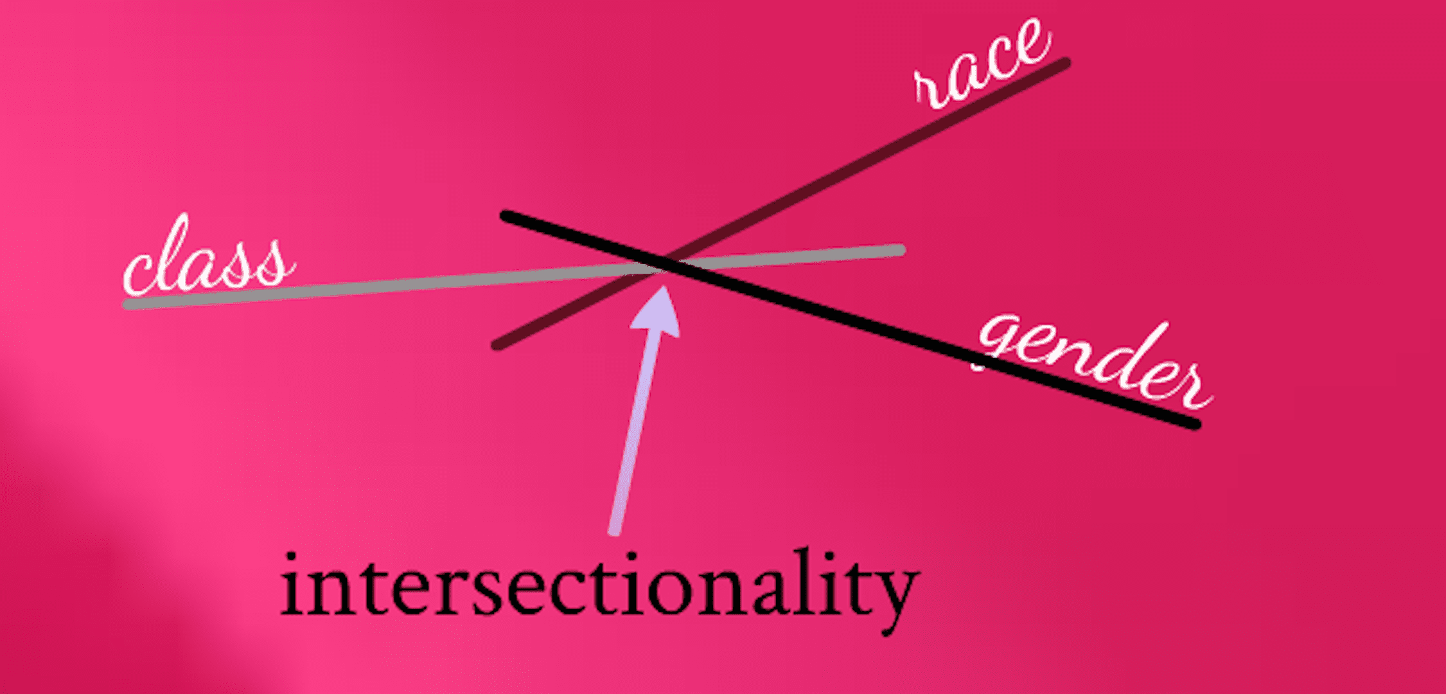
Intersectionality
A central tenet of Black Feminism; First coined by African American legal scholar Kimberlé Crenshaw in her essays “Demarginalizing the Intersection of Race and Sex” (University of Chicago Legal Forum, 1989) and “Mapping the Margins” (Stanford Law Review, 1991).
Crenshaw captures the ways in which race, class, and gender interact to shape experiences of women of color. She argues for the importance of understanding the imbrication of factors that are often treated discretely, such as race, class, and gender. These factors are neither mutually exclusive nor additive but rather intertwine or intersect to create complex situations of oppression.
Intersectionality is distinct from the idea of additive discrimination. Women of color do not simply experience gender discrimination plus racial discrimination as two distinct systems of oppression. Rather, the idea underlying intersectionality is that the particular ways in which race, gender, and other forms of subordination intersect and overlap are mutually constitutive, creating unique experiences and locations of subordination and vulnerability.

Slide 39
Example: The Immigration Reform Act of 1990 and the “battered spouse waiver”
Before 1990: “Under the [original] marriage fraud provisions […], a person who immigrated to the United States to marry a United States citizen or permanent resident had to remain ‘properly’ married for two years before even applying for permanent residents status, at which time applications for the immigrant’s permanent status were required of both spouses.” (Crenshaw 201)
“[U]nder these circumstances, many immigrant women were reluctant to leave even the most abusive of partners for fear of being deported” (Crenshaw 201).
After 1990: Congress, in 1990, added a provision allowing “an explicit waiver for hardship caused by domestic violence” (Crenshaw 201).
“Yet many immigrant women, particularly immigrant women of color, have remained vulnerable to battering because they are unable to meet the conditions established for a waiver. The evidence required to support a waiver ‘can include, but is not limited to reports and affidavits from police, medical personnel, psychologists, school officials, and social service agencies.’” (Crenshaw 201)
  Limited access to these resources
  Lack of privacy (esp. living with extended family)
  Language barriers
  Lack of independent access to information re: their immigration status
  Undocumented family members and fear of inviting scrutiny

Slide 40
What does this example teach us?
“Intersectional subordination need not be intentionally produced; in fact, it is frequently the consequence of the imposition of one burden that interacts with pre-existing vulnerabilities to create yet another dimension of disempowerment” (Crenshaw 202).
“The enactment of the domestic violence waiver of the marriage fraud provisions similarly illustrates how modest attempts to respond to certain problems can be ineffective when the intersectional location of women of color is not considered in fashioning the remedy. Cultural identity and class affect the likelihood that a battered spouse could take advantage of the waiver. Although the waiver is formally available to all women, the terms of the waiver make it inaccessible to some. Immigrant women who are socially, culturally, or economically privileged are more likely to be able to marshal the resources need to satisfy the waiver requirements. Those immigrant women least able to take advantage of the waiver—women who are socially or economically the most marginal—are most likely to be women of color” (Crenshaw 202).

Slide 41
Black Queer Theory
First, what is queer theory?
Queer theory critiques heteronormativity—the politically defined and socially ingrained dominance of heterosexuality; social relations predicated on a binary sex/gender system; and its presumed naturalness.
Queer theory challenges the normalization and naturalization of identities and practices through repetition and boundary enforcement, seeking to reveal and ultimately to undo the social and cultural practices by which these norms are naturalized and rendered invisible (e.g., the use and pairing of “male” and “female” to describe inlet and outlet connections of glassware and other equipment in science labs).
Queer theory assumes the political character of sexual norms and heteronormative logics—how power, resources, and privileges are distributed and maintained.
While the rise of queer theory is commonly associated with ”the poststructuralist turn” of the late 1980s/early 1990s, the concern with destabilizing—queering—fixed notions of sexuality and gender can be traced back to at least the 1970s and the scholarship of lesbian feminists of color, including Barbara Smith, Audre Lorde, Cherríe Moraga, and Gloria Anzaldúa.

Slide 42
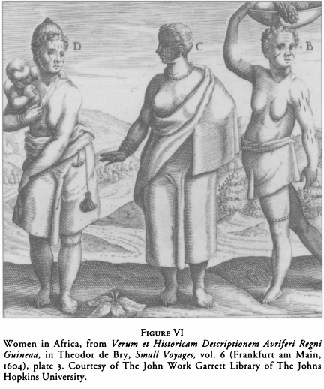
Black Queer Theory
Social Construction of identity:
Queer theory posits that sexuality and gender are socially constructed and contingent rather than indicative of a core identity or distinct and transhistorical category.
Black Queer Theory posits that, yes, sexuality and gender are socially constructed; however, they have been and continue to be constructed through the intersection of race, class, ability, etc.
  Further reading: Jennifer L. Morgan’s Laboring Women (see figure on left), Siobhan Somerville’s Queering the Color Line, and C. Riley Snorton’s Black on Both Sides: A Racial History of Trans Identity

Slide 43
Black Queer Theory
Beyond the “homosexual” as unit of analysis:
Queer theory explores a wide range of pathologized sexual subjects and desires beyond the figure of the “homosexual.”
Black Queer Theory has intervened to include non-normative heterosexual subjects such as sex workers, single mothers, and a multiplicity of queered racial “Others.”
  Further reading: Cathy Cohen’s “Punks, Bulldaggers, and Welfare Queens: The Real Radical Potential of Queer Politics?” and Roderick Ferguson’s Aberrations in Black : Toward a Queer of Color Critique

Slide 44
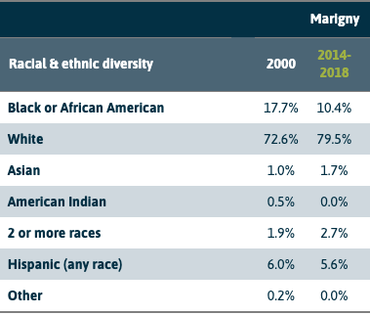
Black Queer Theory and Intersectionality
Black Queer Theory has also worked to destabilize whiteness as the default and privileged subject within queer scholarship, politics, and activism.
For example, Charles I. Nero in “Why Are Gay Ghettoes White?” demonstrates how white cisgender gay men actively and intentionally petitioned banks to deny loans to working-class Black families in order to preserve the “historical charm” of the Faubourg Marigny in New Orleans, LA.
  Primary source: “‘It’s a lot less blue-collar than it used to be,’ says Julian Mutter, a Marigny homeowner since the late 1970s. Now, there are more artists, gay couples and retirees than dockworkers, shopkeepers and young families, he says.’”

Slide 45
Black Queer Theory, Intersectionality, and Compounded Vulnerabilities
Full circle: Queer and Trans* people of color (QTPOC) do not simply experience sexual and gender discrimination plus racial discrimination as distinct and separate systems of oppression.
Rather, the ways in which gender, sexuality, race, class, ability, and other forms of subordination intersect are mutually constitutive.
  That is to say, anti-Blackness determines how one experiences cisheteronormativity, homophobia, and/or trans-antagonism and vice versa.
And these intersections create unique experiences and sites of subordination and vulnerability.
  Examples: We might consider the disproportionate murder of Black Trans women or the over representation of Black men amongst the victims of Jeffery Dahmer—how systemic racism intersects with cisheteropatriarchy and cisheteronormativity to create conditions by which they would be more susceptible to fatal violence.
Eleven of [Jeffrey] Dahmer’s 17 victims were black, and their families have long maintained that the criminal justice system was tilted against them […] decrying ″the blatant examples of racism″ in the case.
[…]
[D]efense lawyer Gerald Boyle insisted his client was motivated by sexual attraction, not racism, when selecting victims. ″This was not racial,″ Boyle said. ″Mr. Dahmer’s obsession was to body form, not color.″
-Associated Press, 1/31/1992

Slide 46
Asking intersectional questions as instructors.
Do course policies, procedures, and practices make worse historical vulnerabilities of underrepresented and underserved student populations or create new ones?
  If so, how?
How can I intentionally mitigate, interrupt, and offset the vulnerabilities that have been and continue to be compounded by intersectionality?

Slide 47
Intersection of Queer Theory, Latin American-US Latinx Studies and Race/Racism
Hector Garcia Chavez

Slide 48
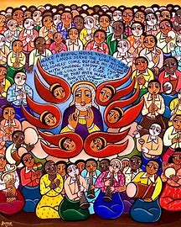
Liberation Theology: A Culturally Receptive Approach
LaShaunda reese MA, MTS
Loyola University Chicago
July 2020

Slide 49
Introduction and Purpose
Presentation of theories stemming from/ steeped in Liberation Theology that may reshape how both instructors and students approach the subject.
Highlight scholarship outside of standard Western theological curriculum.
Encourage faculty and students to transition into Anti-Racist/Culturally Engaging pedagogy as the new norm.
***Wanted to use Culturally Engaging as a more affirming substitution for Anti-Racist***

Slide 50
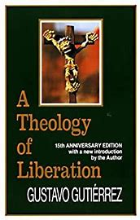
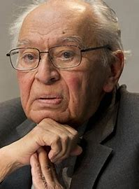
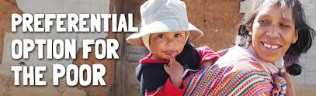
“Theology as critical reflection on historical praxis is a liberating theology, a theology of the liberating transformation of the history of humankind…which openly confesses to Christ.”
- Gustavo Gutierrez, a theology of liberation (1971)

Slide 51
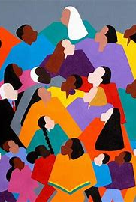
A theory of liberation theology can be considered anti-racist (or culturally engaging) if it does at least 2 of these simultaneously:
It is critical of dominant and exclusive methodologies.
If it illustrates the value in diverse points of dialogue.
If it calls to attention the historical living context of marginalized humanity (intersectionality - race, sex, gender, etc).
If it critically acknowledges the sociopolitical context out of which the subject arises (interdisciplinary in the classroom).
If it is open to dialogue geared towards social transformation.

Slide 52
Three Examples in Liberation Theology
The Dialects of the African Theological Paradigm – Emmanuel Martey
Theology of Struggle - Eleazar S. Fernandez
Lo Cotidiano En La Lucha- Ada Maria Isasi-Diaz

Slide 53
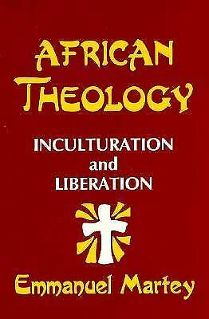
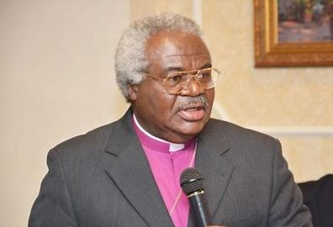
‘The Dialects of the African Theological Paradigm’ – Emmanuel Martey
Ghana Native
African Liberation Theology
Confronts lived situation of oppression and inculturation with hope for liberation.
Healthy point of contention can and should be the point of convergence between North American Black Liberation theology and African Theology.
Finds meaningful method of social transformation within Liberation theology relevant to the contextual histories of parts of Africa.

Slide 54
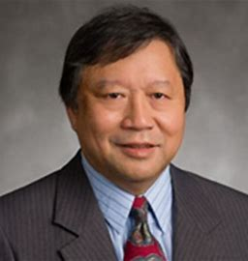
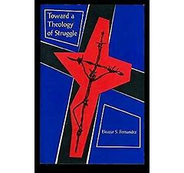
‘Theology of Struggle’ – Eleazar Fernandez
Filipino Native
Confronts colonial oppression at the hands of Spain, North America, and Japan, as well as neo-colonialism.
Focuses on theological voices from the global south as a hermeneutic to theological inquiry.
Intersectionality with globalization and anthropological studies

Slide 55

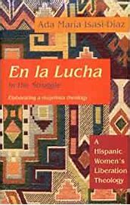
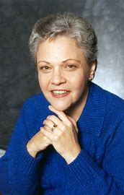
‘Lo Cotidiano – En La Lucha’ Ada Maria Isasi-Diaz
“... diversity is not a matter of different expressions of the same truth, but rather points to differences that touch the very core of who we are and what we believe”- En La Lucha
Cuban-American (born and raised in Cuba)
Mujerista (Liberation) Theology
Translates to ‘the everyday-in the struggle’

Slide 56
Conclusions and Resources
Christianity as a formed religion does not have its center in the United States, or in North America for the that matter. For liberation theology to be framed in an anti-racist/culturally receptive manner, any academic contribution to the field must start from the understanding of liberation theology as historical praxis, a critical integration of theory and practice/action with marginalized humanity as the central subject.
Jane Currie – Reference Librarian; Subject Specialist for Classical Studies, History, Islamic World Studies, Philosophy, Theology, and Women's Studies & Gender Studies– make an appointment: https://libcal.luc.edu/appointments/jane_currie or send her an email – jcurrie@luc.edu
‘…it remains the task of liberation theology today to continue engaging in critical reflection on the human experience of God in history. Liberation theology refers to this process as historical praxis.’ – Phillip J. Linden, Jr., S.S.J., S.T.D., Ph.D

Slide 57
Bibliography and Further Suggestions
https://theo.kuleuven.be/en/research/centres/centr_lib/linden-interview.pdf
Fernandez, Eleazar S. Toward a Theology of Struggle. Orbis Books, 1994.
Inda, Caridad., et al. A Theology of Liberation : History, Politics, and Salvation. Orbis Books, 1973.
Isasi-Díaz, Ada María. En La Lucha = In the Struggle : a Hispanic Women's Liberation Theology. Fortress Press, 1993.
Isasi-Díaz, Ada María. Mujerista Theology : a Theology for Twenty-First Century. Orbis Books, 1996.
Martey, Emmanuel. African Theology : Inculturation and Liberation. Orbis Books, 1993.Century. Orbis Books, 1996.
Amaladoss, M. Life in Freedom : Liberation Theologies from Asia. Orbis Books, 1997.
Tan, Jonathan Y. “Ecumenical and Inter‐Religious Contributions to Asian Liberation Theologies.” The Ecumenical Review, vol. 69, no. 4, 2017, pp. 474–490.
Rambachan, Anantanand. A Hindu Theology of Liberation. State University of New York Press, 2015.
Hennelly, Alfred T. Liberation Theologies : the Global Pursuit of Justice. Twenty-Third Publications, 1995.

Slide 58
Strengths and Limitations of anti-racist pedagogy
Cristian Paredes

Slide 59
Strengths and Limitations of
Anti-racist Approaches
Strengths
  Explicitly challenge racial ideologies
    Stereotypes and prejudice
    Common sense
  Empower non-white (and white) individuals
    An intellectual tool based on racial meaning

Slide 60
Strengths and Limitations of
Anti-racist Approaches
Limitations
  Can overemphasize the significance of racial meaning as a determinant of ethno-racial social problems
  Example: ethno-racial inequality require other analytic approaches
    Intergenerational transmission of wealth
    Class (versus race)

Slide 61
Strengths and Limitations of
Anti-racist Approaches
Limitations relevant for pedagogical techniques
  Anti-racist views challenge misconceptions (stereotypes, prejudice), but students are still going to have misconceptions regardless of race
    Oppression or learning challenges/hurdles?

Slide 62
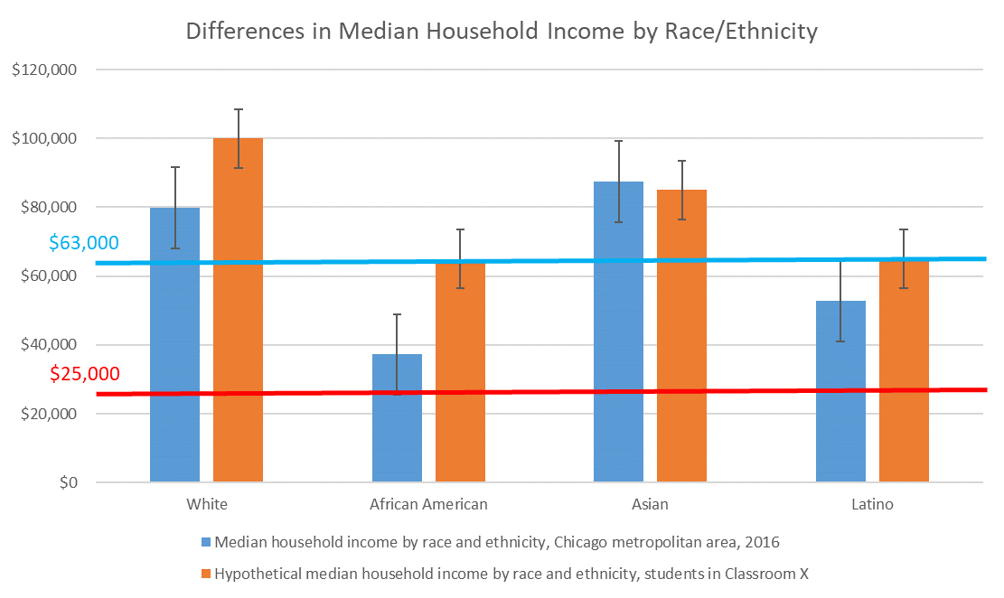
Limitations relevant for pedagogical techniques
  Selectivity: students are not a random sample of the origin population
S3
Share middle-class characteristics
S1
S2
Source: https://www.cmap.illinois.gov/

Slide 63
Q&A
Participants: please use ‘raise hand’ feature; we will call on individuals to share their insights, observations or questions
To all presenters: How are these theories relevant to anti-racist pedagogy in your discipline?
To participants: How can these theories inform how you will move in the direction of anti-racism in your own teaching?

Slide 64
Additional resources
Extensive glossary of related terms
Lecture by UCLA historian and Black Studies scholar Robin D.G. Kelley on racial capitalism
Feminist sociologist and African-American studies scholar Beth E. Richie (at UIC) on feminist anti-racist and anti-carceral approaches to gender and sexual violence

Slide 65
Upcoming events & evaluation
Tuesdays 12:00-1:30pm, same zoom link
July 7: Introduction to Related Pedagogical Theories: Introduction to anti-racist theory, critical race theory, queer theory, feminist theory, liberation theology, and other critical frameworks for considering race, power, and marginalization in our society
July 14: Anti-Racist Course Design Learn how to design course content, syllabi, learning outcomes, assessments and assignments that reflect anti-racist pedagogy.
July 21: Anti-Racist Class Facilitation: Discuss creating class community, responding to resistance, equalizing power, among other themes.
July 28: Advocacy and Taking Action: Consider how to create opportunities for moving ourselves, our students and our communities toward meaningful anti-racist action.
August 4: Closing Discussion Circle: Share thoughts and experiences of the past sessions of the series, current events and the impact on your teaching.

